Slide 1

Building and Analyzing Social Networks
Web Data and Semantics in Social Network Applications
Dr. Bhavani Thuraisingham
February 15, 2013

Slide 2
Outline
Reference: P. Mika, Semantic Web and Social Networks, Springer, 2008: Chapter 3, 4, 5, 6
Electronic Sources for Network Analysis
Knowledge Representation on the Semantic Web
Modeling and Aggregating Social Network Data
Developing Social Semantic Applications

Slide 3
Electronic Sources for Network Analysis
Electronic Discussion Networks
Blogs and Online Communications
Web-based Networks

Slide 4
Electronic Discussion Networks
Communication among employees using email archive
Email networks
  E.g., Enron email network analysis
Build network from the email communications
Public forums and email lists
Group communication

Slide 5
Blogs and Online Communications
Content analysis of blogs (web logs)
Trend analysis of blogs
Online social networks
  Facebook, Twitter, LinkedIn, Foursquare
Sentiment analysis

Slide 6
Web-based Networks
Web pages from a network
Contents of web pages
Mine and analyze the web pages
Web Mining
  Web content mining
  Web structure mining
  Web log mining (who visited the web pages)

Slide 7
Knowledge Representation on the Semantic Web
Ontologies and their role in the semantic web
Ontology languages for the semantic web

Slide 8
Ontologies and Their Role in the Semantic Web
Ontologies are expressed in formal languages with well-defined semantics
Ontologies build upon a shared understanding with a community
RDF and OWL are languages for the semantic web
More expressive languages have less reasoning power

Slide 9
Ontology Languages for the Semantic Web
RDF
RDF Schema
RDF Vocabulary
RDF and FOAF
RDF and Semantics
SPARQL (query language for RDF)
OWL – Web Ontology Language
Comparison to UML and the ER Model

Slide 10
Modeling and Aggregating Social Network Data
Network Data Representation
Ontological Representation of Social Individuals
Ontological Relationship of Social Relationships
Aggregating and Reasoning with Social Network Data

Slide 11
Network Data Representation
Graphs
Matrices
Number the nodes and use the numbers to represent the edges (e.g., 12 means edge between nodes 1 and 2)
GraphML (XML for graphs)
Do not support the aggregation of network data
Key challenges: Identification and Disambiguation

Slide 12
Ontological Representation of Social Individuals
FOAF is an example of an ontological representation of individuals
Eliminates the drawbacks of early social networks like Friendster, Orkut
The early social networks had centralized control and were difficult to manage
FOAF is distributed and has a rich ontology to characterize individuals

Slide 13
Ontological Representation of Social Relationships
Social networks such as FOAF need to be extended to support relationships
Support the integration of social information
Integrates/aggregates multiple social networks
Properties of relationships
  Sign: Positive or Negative relationships
  Strength (e.g., frequency of contact)
  Provenance (different ways of viewing relationships)
  Relationship History
  Relationship roles
Conceptual models for social data – semantic net, RDF

Slide 14
Aggregating and Reasoning with Social Network Data
Representing Identity
  URI (Universal Resource Identifier)
  Disambiguation (A and B are the same; There are two people called John Smith)
  OWL has the “sameAS” property
Equality
    The property sameAs is reflexive, symmetric and transitive
Descriptive Logic vs. Rule based reasoners
  Rule based reasoners use forward chaining and backward chaining
  Descriptive logic is used for classification and checking for ontology consistency

Slide 15
Developing Social Semantic Applications
Building Semantic Web Applications with Social Network Features
Flink: The Social Network of the Semantic Web Community
Openacademia: Distributed semantic web-based publication management

Slide 16
Building Semantic Web Applications with Social Network Data
General Architecture
  Sesame for storage and reasoning (alternative is Jena)
    Sesame manages the data sources
  Sesame Client API
  Querying through SPARQL
  Elmo and associated tools for building ontologies and interfacing to RDF data
Social Network Applications (e.g., FLINK) are built on top of the architecture as applications

Slide 17
Flink: The Social Network of the Semantic Web Community
Flink was developed by Peter Mika; it is a semantic web representation of any online social data
Current instantiation uses semantic web researchers are nodes and their collaboration as links
Visualization tools for visualizing the nodes and links
Flink social networks are decomposed and stored as RDF triples and managed by Sesame

Slide 18
Openacademia: Distributed Semantic Web-based Publication Management
Openacademia is a social network application for maintaining scientific publications
Data from multiple data stores (e.g., FOAF profiles, publications) and access via Elmo crawler
Data converted into RDF and managed by Sesame
Openacademia servlet queries Sesame (SPARQL queries) and aggregates the data and presents to the user

Slide 19
OWL is built on RDFS which helps us to define ontologies.
Ontologies are formal definitions of vocabularies that allow us to define difficult or complex structures and new relationships between vocabulary terms and members of classes that we define.
Ontologies generally describe specific domains such as scientific research areas.
SNA

Slide 20
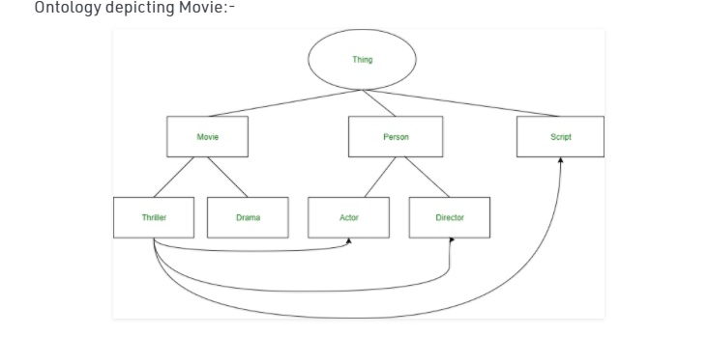
Example:
SNA

Slide 21
Components:
Individuals –
Individuals are also known as instances of objects or concepts.
It may or may not be present in an ontology.
It represents the atomic level of an ontology.
SNA

Slide 22
Components:
For example, in the above ontology of movie,
individuals can be a film (Titanic), a director (James Cameron), an actor (Leonardo DiCaprio).
Classes –
Sets of collections of various objects are termed as classes.
For example, in the above ontology representing movie,
movie genre (e.g. Thriller, Drama), types of person (Actor or Director) are classes.
SNA

Slide 23
Attributes –
Properties that objects may possess.
For example, a movie is described by the set of ‘parts’ it contains like Script, Director, Actors.
Relations –
Ways in which concepts are related to one another.
For example, as shown above in the diagram a movie has to have a script and actors in it.
SNA

Slide 24
Different Ontology Languages:
CycL – It was developed for the Cyc project and is based on First Order Predicate Calculus.
Rule Interchange Format (RIF) – It is the language used for combining ontologies and rules.
Open Biomedical Ontologies (OBO) – It is used for various biological and biomedical ontologies.
Web Ontology Language (OWL) – It is developed for using ontologies over the World Wide Web (WWW).
SNA

Slide 25
Semantic Web and RDF
Semantic Web is an extension to the World Wide Web.
The purpose of the semantic web is to provide structure to the web and data in general.
It emphasizes on representing a web of data instead of web of documents.
SNA

Slide 26
It allows computers to intelligently search, combine and process the web content based on the meaning that the content has.
Three main models of the semantic web are:
Building models
Computing with Knowledge
Exchanging Information
SNA

Slide 27
Building Models:
Model is a simplified version or description of certain aspects of the real-time entities.
Model gathers information which is useful for the understanding of the particular domain.
SNA

Slide 28
Computing Knowledge:
Conclusions can be obtained from the knowledge present.
Example:
If two sentences are given as ‘John is the son of Harry’ and
another sentence given is- ‘Hary’s father is Joey’,
then the knowledge that can be computed from it is – ‘John is the grandson of Joey’
Similarly,
another example useful in the understanding of computing knowledge is-
‘All A is B’ and ‘All B is C’, then the conclusion that can be drawn from it is – ‘All A are C’ respectively.
SNA

Slide 29
Exchanging Information:
It is an important aspect.
Various communication protocols have been implemented for the exchange of information like the TCP/IP, HTML, WWW.
Web Services have also been used for the exchange of the data.
SNA

Slide 30
The technologies associated with the semantic web are:
RDF (Resource Description Framework)
OWL (Web Ontology Language)
DL (Description Language)
The query language used is:
SPARQL ( SPARQL Protocol and RDF query language).
SHACL (Shape Constraint Language). SHACL is used for validating the RDF graphs against a set of conditions.
SNA

Slide 31
Resource Description Framework
RDF:
It is the formal language for describing structured information.
The primary goal of RDF is to exchange data on the web while preserving the original meaning of the data.
It is a data model that is used to describe resources.
For Example
Physical Things, Abstract Concepts, Numbers and Strings.
SNA

Slide 32
RDF allows the processing of information. RDF representation can be in the form of triples and graphs.
SNA

Slide 33
RDF graph is a directed graph which is used to serve as a description language for data on the world wide web and other electronic networks.
Resources are described using triples.
Triples capture the relationship between the subject and the object.
Triples have a subject, predicate and an object.
Triples are enclosed within angular brackets.
SNA

Slide 34
Example: Delhi is capital of India
The triple generated from this sentence is:
<Delhi> <capital of> <India>.
, where Delhi is the subject, capital of is the predicate and India is the object.
The triples can also be represented in the form of URIs (Uniform Resource Identifier).
Example of URI triple:
<http://www.abc.org/subject/Delhi>
<http://www.abc.org/predicate/capitalOf>
<http://www.abc.org/object/India>.
Every statement is terminated by a full-stop in RDF triple.
SNA

Slide 35
Humans are best at understanding, reasoning, and interpreting knowledge.
Human knows things, which is knowledge and as per their knowledge they perform various actions in the real world.
But how machines do all these things comes under knowledge representation and reasoning.
Hence we can describe Knowledge representation as following:
SNA

Slide 36
Knowledge representation and reasoning (KR, KRR) is the part of Artificial intelligence which
concerned with AI agents thinking and how thinking contributes to intelligent behavior of agents.
SNA

Slide 37
It is responsible for representing information about the real world so that a computer can understand and
can utilize this knowledge to solve the complex real world problems such as diagnosis a medical condition or communicating with humans in natural language.
SNA

Slide 38
It is also a way which describes how we can represent knowledge in artificial intelligence.
Knowledge representation is not just storing data into some database,
but it also enables an intelligent machine to learn from that knowledge and experiences so that it can behave intelligently like a human.
SNA

Slide 39
What to Represent:
Following are the kind of knowledge which needs to be represented in AI systems:
Object: All the facts about objects in our world domain. E.g., Guitars contains strings, trumpets are brass instruments.
Events: Events are the actions which occur in our world.
Performance: It describe behavior which involves knowledge about how to do things.
Meta-knowledge: It is knowledge about what we know.
Facts: Facts are the truths about the real world and what we represent.
Knowledge-Base: The central component of the knowledge-based agents is the knowledge base. It is represented as KB.
The Knowledgebase is a group of the Sentences (Here, sentences are used as a technical term and not identical with the English language).
SNA

Slide 40
Knowledge: Knowledge is awareness or familiarity gained by experiences of facts, data, and situations.
Following are the types of knowledge in artificial intelligence:
SNA

Slide 41
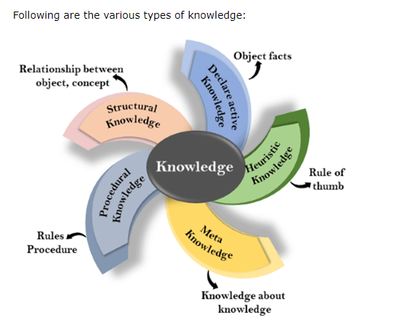
SNA

Slide 42
Declarative Knowledge:
Declarative knowledge is to know about something.
It includes concepts, facts, and objects.
It is also called descriptive knowledge and expressed in declarative sentences.
It is simpler than procedural language.
SNA

Slide 43
Procedural Knowledge
It is also known as imperative knowledge.
Procedural knowledge is a type of knowledge which is responsible for knowing how to do something.
It can be directly applied to any task.
It includes rules, strategies, procedures, agendas, etc.
Procedural knowledge depends on the task on which it can be applied.
SNA

Slide 44
Meta-knowledge:
Knowledge about the other types of knowledge is called Meta-knowledge.
4. Heuristic knowledge:
Heuristic knowledge is representing knowledge of some experts in a filed or subject.
Heuristic knowledge is rules of thumb based on previous experiences, awareness of approaches, and which are good to work but not guaranteed.
SNA

Slide 45
Structural knowledge:
Structural knowledge is basic knowledge to problem-solving.
It describes relationships between various concepts such as kind of, part of, and grouping of something.
It describes the relationship that exists between concepts or objects.
SNA

Slide 46
Approaches to knowledge representation:
There are mainly four approaches to knowledge representation,
which are givenbelow:
SNA

Slide 47
Simple relational knowledge:
It is the simplest way of storing facts which uses the relational method,
and each fact about a set of the object is set out systematically in columns.
This approach of knowledge representation is famous in database systems
where the relationship between different entities is represented.
This approach has little opportunity for inference.
SNA

Slide 48
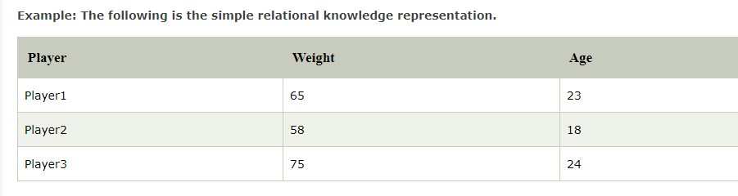
SNA

Slide 49
Inheritable knowledge:
In the inheritable knowledge approach, all data must be stored into a hierarchy of classes.
All classes should be arranged in a generalized form or a hierarchal manner.
In this approach, we apply inheritance property.
Elements inherit values from other members of a class.
This approach contains inheritable knowledge which shows a relation between instance and class, and it is called instance relation.
Every individual frame can represent the collection of attributes and its value.
In this approach, objects and values are represented in Boxed nodes.
We use Arrows which point from objects to their values.
SNA

Slide 50
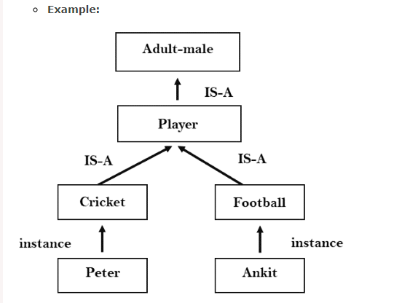
SNA

Slide 51
Inferential knowledge:
Inferential knowledge approach represents knowledge in the form of formal logics.
This approach can be used to derive more facts.
It guaranteed correctness.
Example: Let's suppose there are two statements:
  Marcus is a man
  All men are mortal
  Then it can represent as;
  man(Marcus)
  ∀x = man (x) ----------> mortal (x)s
SNA

Slide 52
Procedural knowledge:
Procedural knowledge approach uses small programs and codes which describes how to do specific things, and how to proceed.
In this approach, one important rule is used which is If-Then rule.
In this knowledge, we can use various coding languages such as LISP language and Prolog language.
We can easily represent heuristic or domain-specific knowledge using this approach.
But it is not necessary that we can represent all cases in this approach.
SNA

